Slide 1

Three Instruction Word Formats
Register Format (R-Format)
op
rs
rt
rd
shamt
funct
6 bits
5 bits
5 bits
5 bits
5 bits
6 bits
Instruction fields
op: operation code (opcode)
rs: first source register number
rt: second source register number
rd: destination register number
shamt: shift amount (00000 for now)
funct: function code (extends opcode)

Slide 2
Three Instruction Word Formats
Immediate Format (I-Format)
Op-Code Rs Rt 16 - Bit Immediate Value
6 5 5 16
Immediate arithmetic and load/store instructions
rt: destination or source register number
Constant: –2¹⁵ to +2¹⁵ – 1
Address: offset added to base address in rs

Slide 3
Jump Format (J-Format)
Three Instruction Word Formats
Op-Code 26 Bit Current Segment Address
6 26
jump instruction;
j 10000; go to target address 10000
jal 10000; $31 = PC + 4; go to 10000; for procedure call,
; return address is saved in $31

Slide 4
Convert the following to Machine Code:
Sub $t0,$s4,$s5
op
rs
rt
rd
shamt
funct
6 bits
5 bits
5 bits
5 bits
5 bits
6 bits
Go and check MIPS reference Data

Slide 5
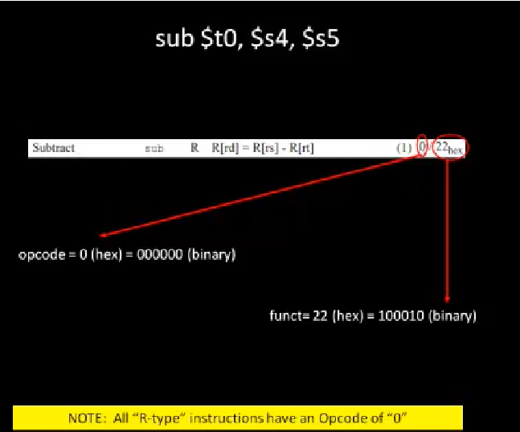
Go and check MIPS reference Data

Slide 6
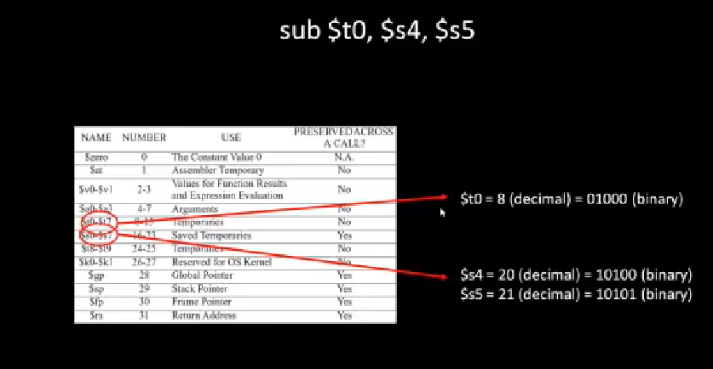
Next, we need to determine the registers numbers

Slide 7
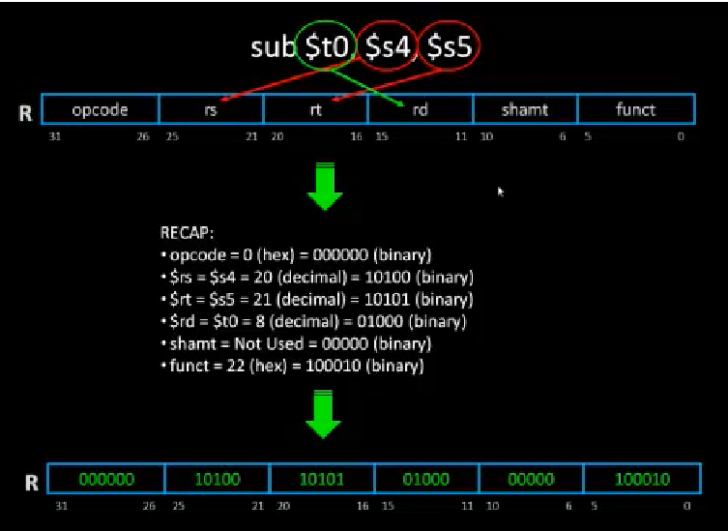
0x29540022

Slide 8
How to convert MIPS Assembly to Machine language.
Convert the following instruction into a machine language:
Slti $t1, $a0, 0xf8
https://courses.cs.washington.edu/courses/cse378/09au/MIPS_Green_Sheet.pdf
Op-Code Rs Rt 16 - Bit Immediate Value
6 5 5 16
Immediate arithmetic and load/store instructions
rt: destination or source register number
Constant: –2¹⁵ to +2¹⁵ – 1
Address: offset added to base address in rs

Slide 9
How to convert MIPS Assembly to Machine language.
t1: destination
a0: Source
Convert the following instruction into a machine language:
Slti $t1, $a0, 0xf8
0 | 0 | 1 | 0 | 1 | 0 | 0 | 0 | 1 | 0 | 0 | 0 | 1 | 0 | 0 | 1 | 0 | 0 | 0 | 0 | 0 | 0 | 0 | 0 | 1 | 1 | 1 | 1 | 1 | 0 | 0 | 0
Op-Code
Rs
Rt
f
8
6
5
5
a
a0
16 - Bit Immediate Value
$t1
0 | 0 | 1 | 0 | 1 | 0 | 0 | 0 | 1 | 0 | 0 | 0 | 1 | 0 | 0 | 1 | 0 | 0 | 0 | 0 | 0 | 0 | 0 | 0 | 1 | 1 | 1 | 1 | 1 | 0 | 0 | 0
2
8
8
9
0
0
f
8
0x288900f8
Hexadecimal representation

Slide 10
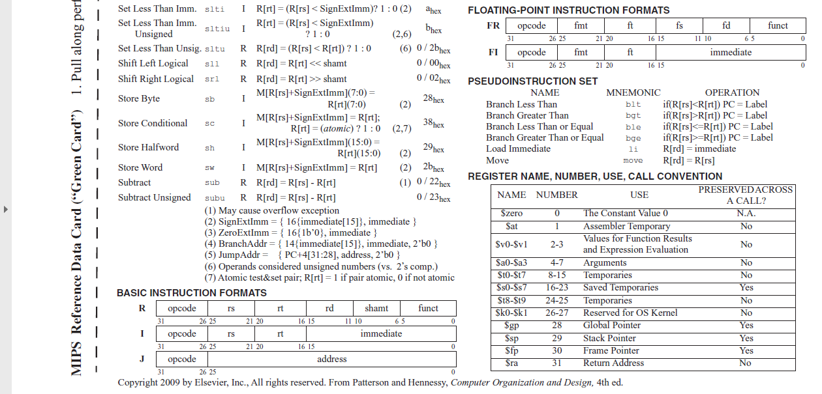

Slide 11
Convert the following Machine Code to MIPS Instructions
0 | 0 | 1 | 0 | 1 | 0 | 0 | 0 | 1 | 0 | 0 | 0 | 1 | 0 | 0 | 1 | 0 | 0 | 0 | 0 | 0 | 0 | 0 | 0 | 1 | 1 | 1 | 1 | 1 | 0 | 0 | 0
Slti $t1, $a0, 0xf8

